Slide 1
Introduction to Agile
Dr Steffen Zschaler
Notes:
<CTRL-SHIFT-HOME><CTRL-SHIFT-2>
Welcome.
I hope that in your discussion of product vs project based development you have realised that different types of projects need a different approach to software development: a scoped project can work with a much more rigidly defined and pre-planned process than a product-based development, where we may need to be able to respond to changes in the market much more rapidly and introduce new features quickly before we lose an opportunity.
Let’s see where this thought leads us.

Slide 2
Rapid software development
Rapid development and delivery (“Time to Market) is now often the most important requirement
Especially for product-based development, but increasingly also for project-based work
Businesses operate in a fast-changing world
Producing a stable set of software requirements is practically impossible
Software has to evolve quickly to reflect changing business needs
Perfect software next year is less useful than OK software tomorrow
Plan-driven development
Essential for some types of system as can give strong quality assurances
Does not meet time-to-market business needs
Agile development methods
Emerged in the late 1990s
Aim to radically reduce delivery time for working software systems
Notes:
Increasingly, we are seeing a push towards faster software development and “time to market”. This is certainly true for product-based development, but increasingly can also be seen in project-based work.
There are good reasons for this:
Businesses must be able to respond to a quickly changing environment or risk going bust.
Thus, perfect software next year is often less useful than OK software tomorrow that can incrementally grow.
Importantly, also, because many of the problems we address are “wicked”, producing a stable and complete set of requirements is often practically impossible.
For a long time, software development typically followed a strongly plan-driven approach, where all stages of the process were carefully planned out ahead of time and then executed in a largely sequential fashion with only occasional loop backs for refinement purposes.
This continues to be important for software development in high-risk domains where we need very strong quality assurances – here high quality is much more important than fast turnaround.
But plan-driven development is very difficult to align with the need for speedy time-to-market that businesses need.
As a reaction to the shortcomings of plan-driven development, the late 1990s saw the emergence of a new approach called agile development.
“Agile” has developed to encompass a hodge-podge of different methods, all of which aim to radically reduce the time it takes to deliver working software to customers.

Slide 3
Plan-driven and agile development
Plan-driven development
Based around separate development stages with outputs to be produced at each stage
Planned in advance
Not necessarily waterfall: plan-driven, incremental development is possible
Iteration occurs within activities
Agile development
Specification, design, implementation and testing are inter-leaved
Outputs from development process are decided through negotiation during software development
Notes:
Let’s compare the two approaches a little bit more carefully:
Plan-driven development is focused on structuring the overall development process into distinct stages with clear outputs to be produced at each stage.
This is carefully planned in advance with milestones, deadlines and deliverables etc.
Note that plan-driven doesn’t necessarily mean “waterfall”: incremental development can also be plan-driven in the sense that we would produce a careful plan of each iteration.
Within the stages of development, there will also often be a level of iteration.
<ANIMATE>
In contrast, agile development proposes to inter-leave all stages of software development (specification, design, implementation and testing) in tight iterations.
There is no fixed plan for the duration of a software project. Instead, planning and acting happen more dynamically and in continual negotiation between the development team and the relevant stakeholders.

Slide 4
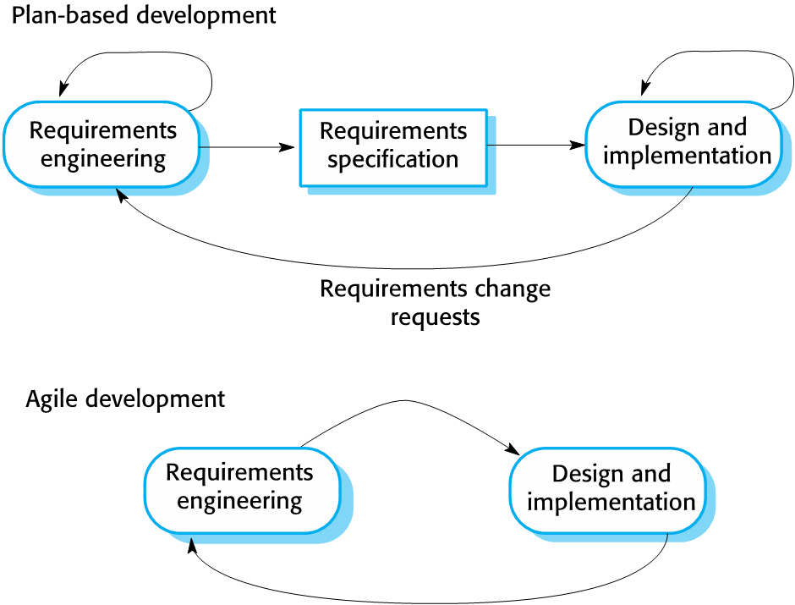
Agile development
Basic principles
Program specification, design and implementation are inter-leaved
System developed as a series of increments
Stakeholders involved in version specification and evaluation
Frequent delivery of new versions for evaluation
Quickly respond to changing requirements
Extensive tool support (e.g. automated testing tools) used to support development
Focus on working code
Minimal documentation
Minimal (no) design
Notes:
Let’s zoom in a little bit.
Here you can see a high-level view of plan-based development vs agile development.
Note how, in the plan-based approach, there is a clear sequence of stages and going back from design to requirements requires an explicit and potentially costly planning process known as a “change request”.
In contrast, agile methods aim to continually iterate between, a little bit of, requirements engineering and, a little bit of, design and implementation.
<ANIMATE>
Program specification and implementation are tightly interleaved and the final system is developed as a series of small increments rather than a “big-bang” delivery at the end of a time-bounded project.
Agile emphasises the need to have stakeholders involved throughout the software development process rather than just at the beginning and end of the process.
Frequent delivery of new versions (increments) enables frequent feedback from stakeholders and means that development can respond quickly to changes in requirements.
Agile needs extensive tool support to allow teams to keep track of the state of the project and the state and quality of the software being developed.
There is often a strong focus on working code over documentation and detailed design, which are seen as a waste of time by some agilists. It’s worth taking a critical stance on this: clearly this must be about the right balance rather than an either-or kind of decision.

Slide 5

Agile manifesto
We are uncovering better ways of developing software by doing it and helping others do it. Through this work we have come to value:
That is, while there is value in the items on the right, we value the items on the left more.
© 2001, the above authors this declaration may be freely copied in any form, but only in its entirety through this notice.
Individuals and interactions | over | processes and tools
Working software | over | comprehensive documentation
Customer collaboration | over | contract negotiation
Responding to change | over | following a plan
Kent Beck Mike Beedle Arie van Bennekum Alistair Cockburn Ward Cunningham Martin Fowler | James Grenning Jim Highsmith Andrew Hunt Ron Jeffries Jon Kern Brian Marick | Robert C. Martin Steve Mellor Ken Schwaber Jeff Sutherland Dave Thomas
https://agilemanifesto.org/
Notes:
These principles have been captured in the so-called “agile manifesto” in 2001.
The manifesto has been signed by many of the people who originally developed the key ideas through their own practice and experience.
If you don’t know the names on the list, do look them up some time!
The key part of the manifesto is the list of contrasts in the middle. These shouldn’t be read to say that there is no value in the things on the right, but that the things on the left are considered to be of more value by the proponents of agile development.
We will discuss these ideas in more detail in a moment.
A manifesto is a tricky beast: it is a powerful and pithy way of getting attention for an idea, but at the same time it is also necessarily reductionist and doesn’t leave much space for a nuanced discussion. We will see later what effects this has had on the way in which “agile” has been discussed and applied in the industry.

Slide 6
The principles of agile methods
Principle | Description
Customer involvement | Customers should be closely involved throughout development process Role: provide and prioritize new system requirements, evaluate system iterations
Incremental delivery | Software developed in increments Customer specifies requirements for each increment
People not process | Recognise and exploit skills of development team Leave team members to develop their own ways of working No prescriptive processes
Embrace change | Expect system requirements to change Design system to accommodate future changes
Maintain simplicity | Focus on simplicity in both software and development process Actively work to eliminate complexity from system
Notes:
So let’s take a closer look at some of the core principles underpinning agile development.
Customer involvement: Agile methods place a lot of emphasis on communication between people and a key group of people that need to be involved in software development are the software’s customers. Their role is to provide and prioritise system requirements and to evaluate and provide feedback on product iterations. Many agile methods push for a very close interaction with customers, to the point where some ask for customers to become part of the development team.
Incremental delivery: Rather than delivering software as one big chunk, agile development argues for an incremental delivery of software, where each increment creates value for the customer.
People not process: Rather than trying to organise work through a tightly prescriptive process, proponents of “agile” believe in allowing skilled software developers (some people refer to these as “software craftsmen”) to identify and manage the best ways in which they can deliver value to customers.
Embracing change: this is at the heart of any agile approach: rather than assuming a fixed set of requirements can be produced and then realised over a long time span, agile proponent propose to make an expectation of change the core of your development approach. This can be seen in the incremental nature of the development process, which delivers small scale improvements and uses feedback to adjust the future path of development. It also affects the structure of the software to be implemented and the techniques used for coding. For example, many agile approaches introduce a number of approaches to structuring and restructuring program code so as to make it as easy as possible to accommodate future changes.
Maintain simplicity: A key reason for the emergence of agile software development approaches was a perception that plan-driven processes were too cumbersome and bureaucratic, making it difficult to deliver software efficiently. Many agile approaches, therefore, aim to eliminate complexity from the system and the development process wherever possible.

Slide 7
Agile method applicability
Product development
Software company develops small or medium-sized product for sale
Virtually all software products and apps are now developed using an agile approach
Custom system development
Where there is clear commitment from customer to become involved in development process
Where there are few external rules and regulations that affect the software
Notes:
So, when are agile methods useful?
In most product-development settings, agile approaches are likely to be beneficial. This is particularly the case for many modern software products that typically include a mechanism for regular automated updates even after the customer has bought the software. The shift from a one-off purchase of software to a rolling license fee model (think Office 365, many apps, …) is a way of funding continual, incremental development of new features in an agile manner.
In a more project-based setting focused on a custom system, agile may be more challenging to apply as it can make scoping the project upfront – and thus agreeing a fixed price and set of features – more challenging. It is, therefore, important to have clear commitment from the customer to an agile approach and to becoming involved in the development process throughout.
In contexts where there are lots of external rules and regulations affecting the software, agile may be more difficult, too, as external regulators may be required to sign-off designs before they can be implemented.

Slide 8
Agile Development Techniques
Extreme Programming
One of the first agile approaches
Introduced a lot of fundamental techniques
Kanban
The beginnings of a development process
Scrum
A common agile software development process
Agility at scale
Moving from small teams and small systems to large teams and systems
Notes:
Over the remainder of the week, we will look at a number of agile techniques. We will do so by looking at some specific examples that have been developed over time (and roughly in the order shown). These are examples of agile programming techniques, approaches to agile process management, and considerations for scaling agile to larger software projects and larger teams.
We will start <ANIMATE> by looking at Extreme Programming in the next video on KEATS.
<CTRL-SHIFT-END>

